Slide 1
Examining the Hydrologic Properties of the Missouri River Basin
Rachel Bash, Keqi He, Caroline Watson, Haoyu Zhang

Slide 2
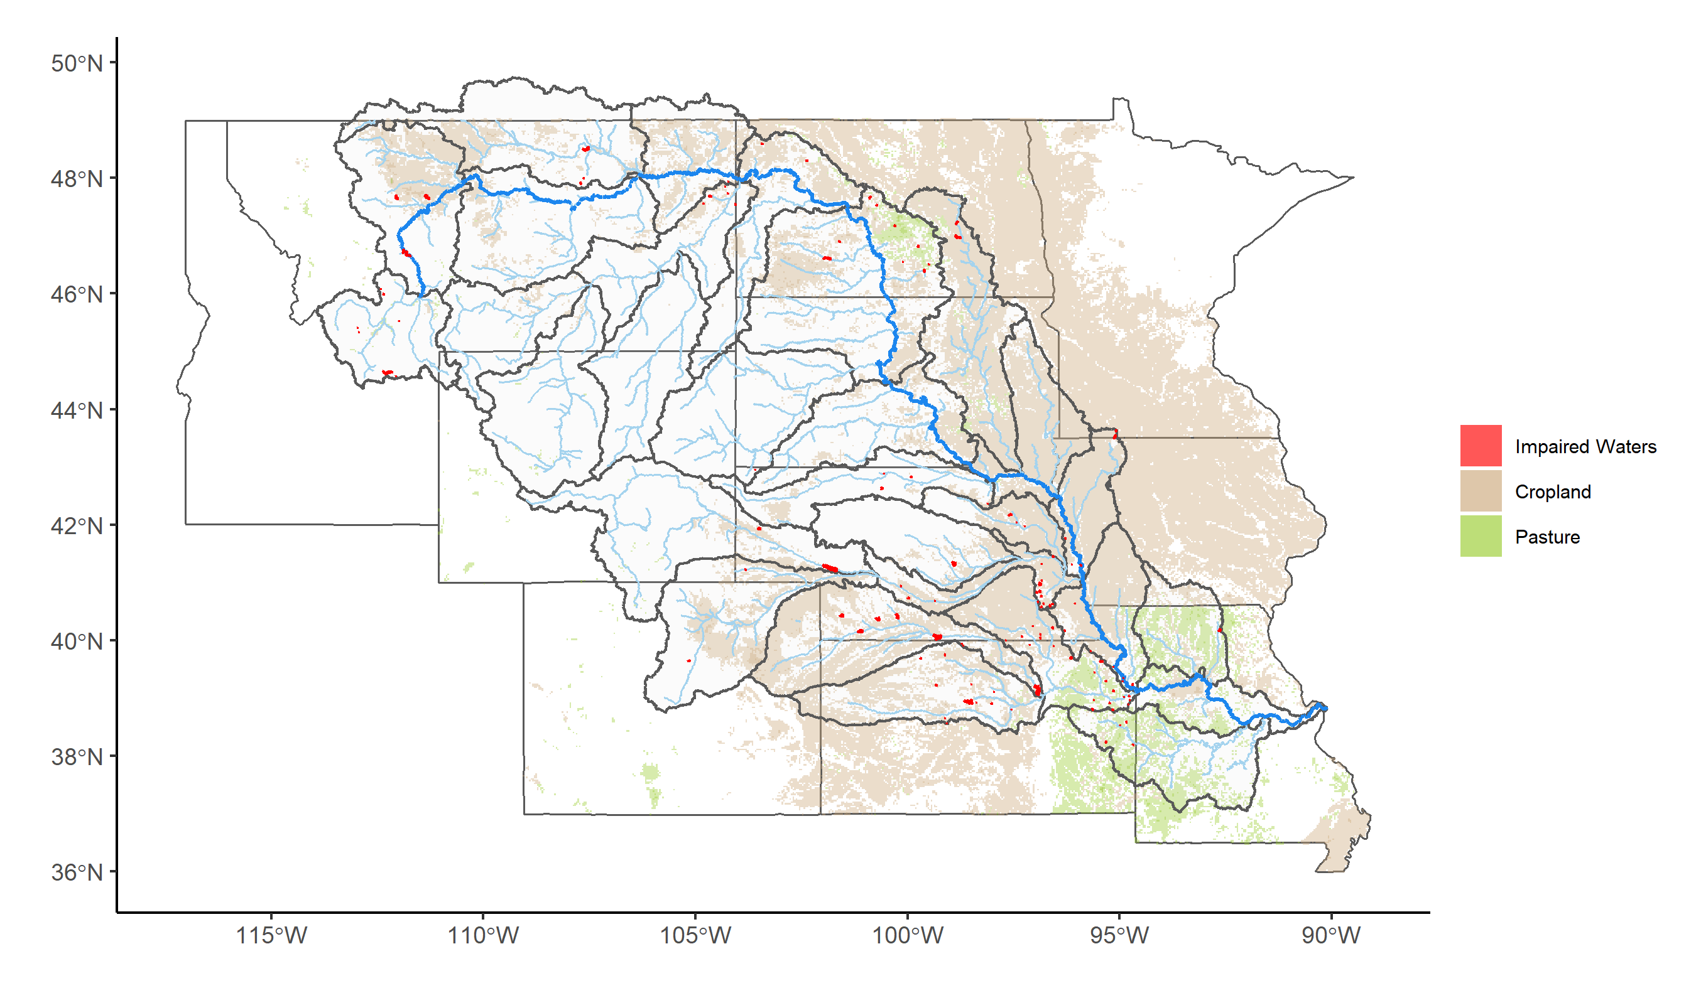
Study Rationale
Insert citations here
Notes:
Hubert

Slide 3
Our Research Questions
How have changes in discharge (i.e. water quantity) interacted with nutrient enrichment (i.e. water quality) in the Missouri River Basin?
a) Nutrient levels have increased over time
b) Discharge has become more variable over time
c) Nutrient levels increase with discharge
What effects do specific flood and drought events have on the water quality and quantity of rivers in the Missouri River Basin areas of interest?
a) Rivers will exhibit a flushing behavior due to the land use and type of flow during storms
b) Discharge will decrease during drought due to decreased overland flow.
What factors contribute to the variability of total nitrogen in the rivers?
a) Land use, year, discharge, phosphorus, and HUC region will contribute to the variability of total nitrogen across sites
Given past and current data, what can we predict about the future state of water in the Missouri River Basin?
a) Total flow in the Missouri River Basin is increasing (non-stationary) over time
b) The future situation of the river basin will see the continuation of current trends of increasing overall volume of flow.
Notes:
caroline

Slide 4
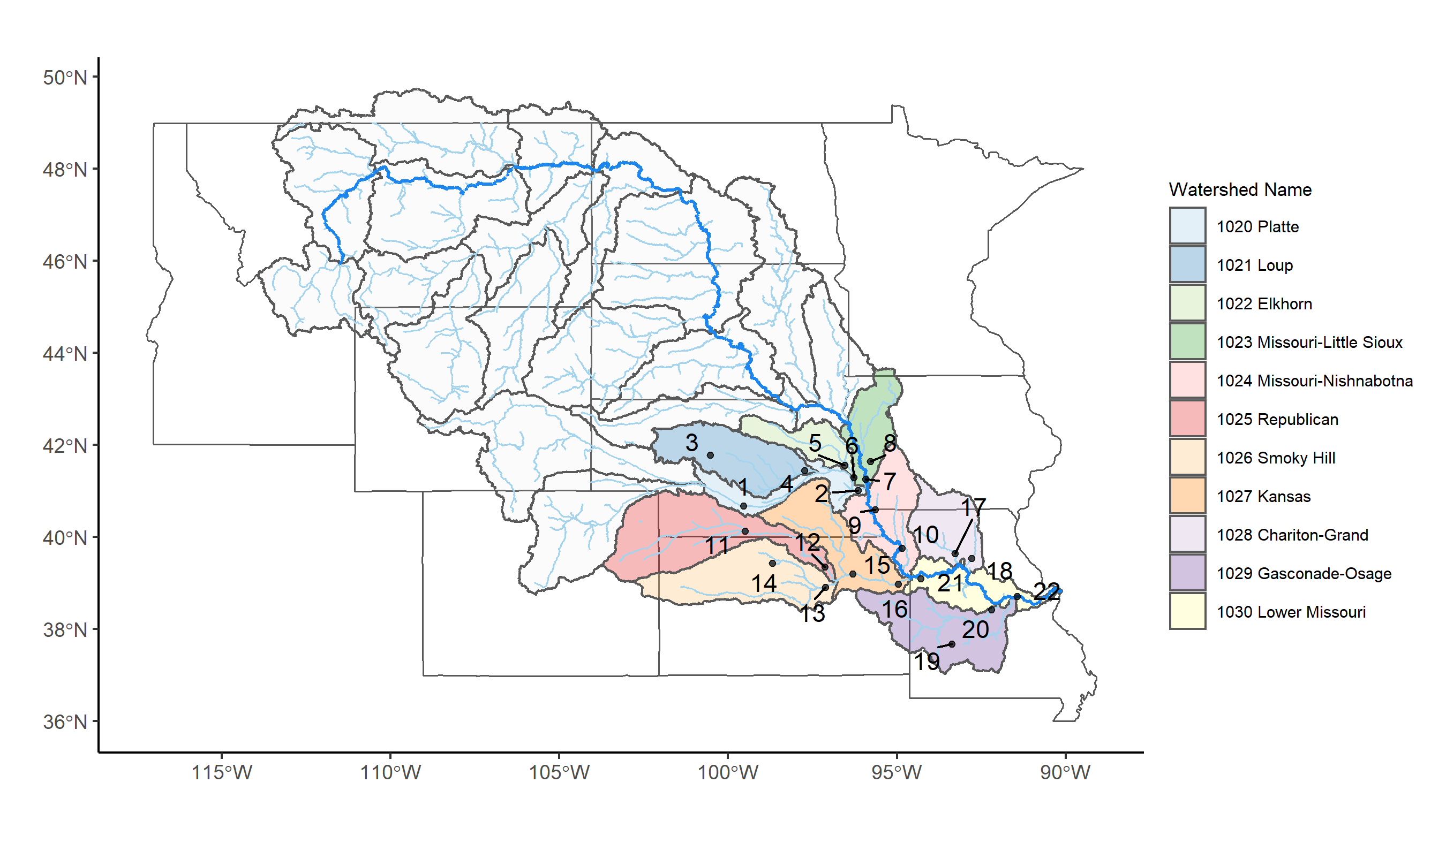
Our Approach
22 sites chosen throughout HUCs 1020 – 1030
2 sites per HUC
Nitrogen, Phosphorus, Discharge, Time
Notes:
Caroline

Slide 5
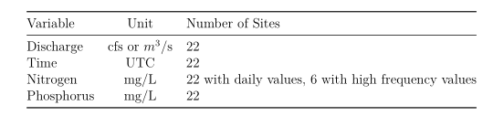
Dataset Information
Source: The United States Geological Survey (USGS) database
National Water Information System (NWIS) https://waterdata.usgs.gov/nwis
Steps:
Filter sites in HUC 1020 - 1030 to only show us sites that contained discharge, nitrogen, and phosphorus data.
Choose 2 sites from each HUC sub basin for a total of 22
By comparing the periods of records for each chosen variables and finding the sites with the longest periods of records.
Two sites per HUC region: maintain a digestible scope.
Notes:
keqi

Slide 6
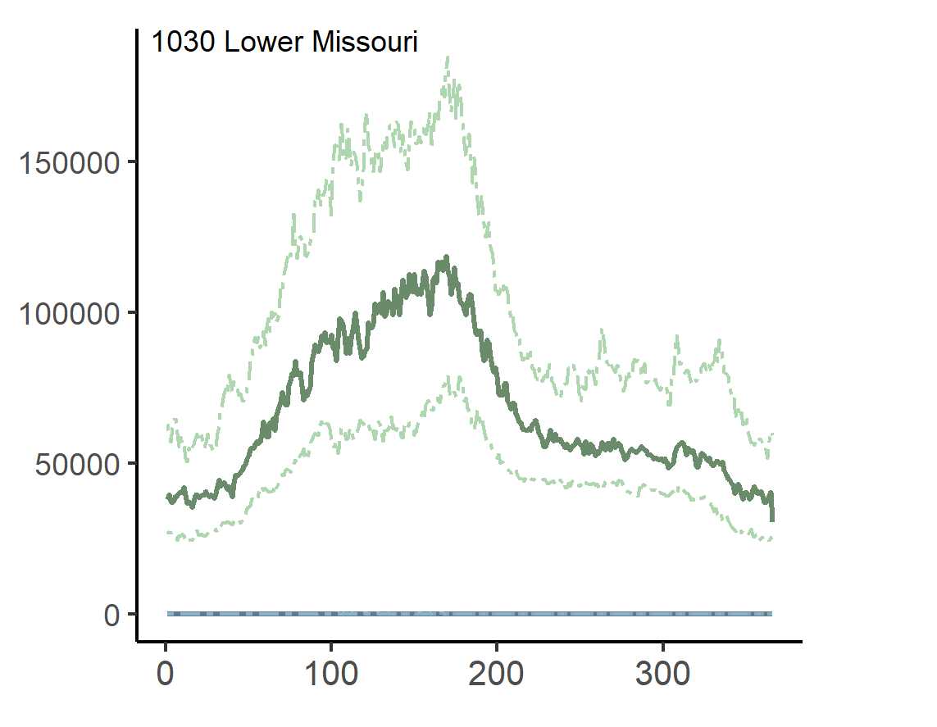
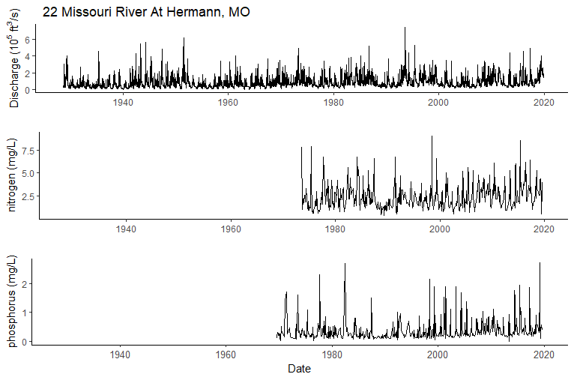
Exploratory Analysis
Day of year
Notes:
rachel

Slide 7
Q1: How have changes in discharge (i.e. water quantity) interacted with nutrient enrichment (i.e. water quality) in the Missouri River Basin?
Notes:
Hubert

Slide 8
Q2: What effects do specific flood and drought events have on the water quality and quantity of rivers in the Missouri River Basin areas of interest?
Notes:
Caroline

Slide 9
Q3: What factors contribute to the variability of total nitrogen in the rivers?
$$\log{(Nitrogen)}=−3.68+0.0299\left(\frac{Year}{10}\right)−9.95{∗10}^{−4}\left(\frac{population}{1000}\right)$$
Fixed effects: Year and population
Random effect HUC 4 area
Exponentiating the coefficients produces integers with multiplicative effects on nitrogen
Discharge was not significant
Notes:
Rachel

Slide 10
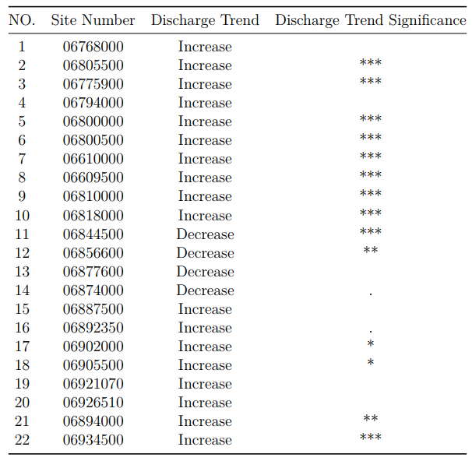
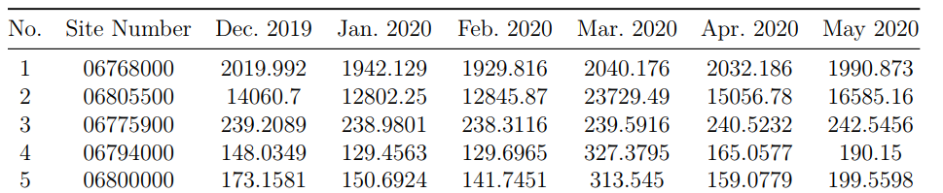
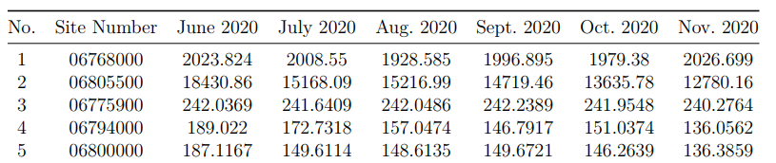
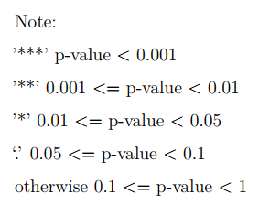
Q4: Given past and current data, what can we predict about the future state of water in the Missouri River Basin?
Mann-Kandall Trend Test
Autoregressive and Moving Average Models (ARMA)
AR part: involves regressing the variable on its own lagged (i.e., past) values
MA part: involves modeling the error term as a linear combination of error terms occurring contemporaneously and at various times in the past
Notes:
Keqi

Slide 11
Conclusions

